Slide 1
No Cloud is an Island
Tuesday June 19, 2012 Vincent in ‘t Veld, Director Cloud Segment

Slide 2
Interxion at a Glance
Headquartered near Amsterdam
Founded 1998
First operator across Europe
29 data centres in 11 countries
70,000 sqm colocation space
400+ carriers/ISPs and 18 Internet Exchanges
Over 1,400 unique customers
~ 350 employees

Slide 3
Ireland at a glance
Established in Dublin 2001
DUB 1 and 2
5,458 sqm space
80+ clients
35+ carriers
Proven track record and reputation
Focus on the client

Slide 4
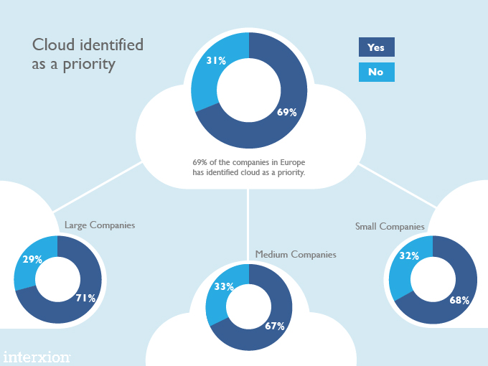
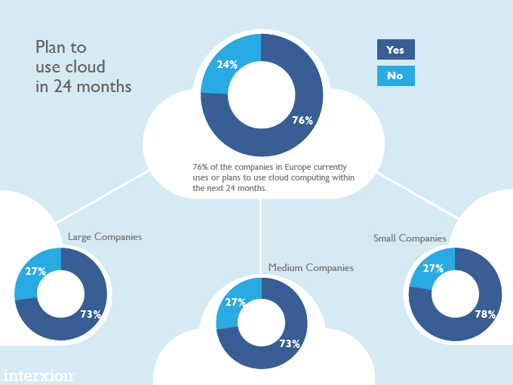
Cloud Today

Slide 5
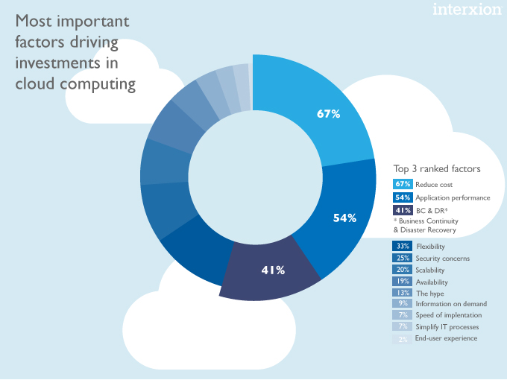
Factors driving Cloud Investments

Slide 6
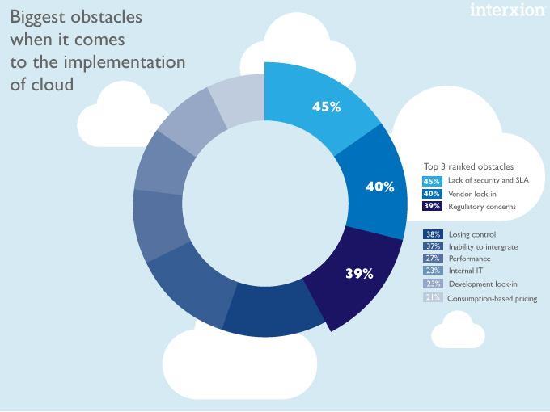
Obstacles to Cloud Implementation

Slide 7
We live in a world of many clouds
1 new server is added to the cloud for every 600 smartphones
How much cloud do you want?
126 million tasks performed on IBM/Google cloud during cloud research project
125 million users are signed up to Apple’s iCloud
$150 billion is the expected value of cloud computing by 2020
5 GB of free space on Google Drive, 1,364 the size of the first commercial hard drive
14 million developers are in Oracle online communities
Efficiency
Resource to needs
Reduce TCO
Notes:
Today we see a world of many clouds.
Most enterprises approach cloud in silo’s and many applications (SaaS) are vertically integrated on their own clouds. Enterprises migrate to the cloud based on the shift of Capex to Opex.
There is no integrated solution - No enterprise class SLA - They just take one cloud at a time.
There is a new cloud popping up every month. And the question is, how much cloud do you want?

Slide 8
Transformation Process
Transformation
Dedicated
Utility
DIY
(on premise)
Service Provider
SaaS
Application
Compute Infrastructure
Managed
Hosted (private cloud)
Shared (public cloud)
Data Centre
Technical Infrastructure
Transformation
SIs & VARs
Consultancy & Resell
Hybrid Solutions

Slide 9
Cloud and Applications Mapped on Performance and Availability
Performance
Backup & Recovery
Email & Calendar
CRM
Payments & Transactions
Private Cloud
Unified
Communication
Black Box (M2M) Trading
Availability
Analytics
(Big Data)
HRM
ERP
Finance & Accounting
Virtual Desktops
Network Storage
Test & Development
Web Browsing
Document Management
Public Cloud
Gaming
Video & Live Streaming
High < 80ms RTD
Medium < 40ms RTD
Low < 20ms RTD
< 1ms RTD

Slide 10
Enterprise needs drive Hybrid
Planned or unplanned peaks in capacity
How to migrate?
How to connect?
Develop & Deploy
Working with large data sets
Real time data feeds
Private
Clouds
Public
Clouds
Hybrid
Distributed
applications
How to manage?
Notes:
The next few years, we will witness the Rise of the Hybrid Cloud.
Go from a world of many clouds to a few cloud-of-clouds. And that’s what hybrid is, a combination of multiple, public and private clouds.
Enterprises will combine their private cloud (for data and core applications) with public cloud (backup, archiving, analytics) and software as a service.
Enterprises will seek to achieve the benefits of cloud computing: scalability, lower TCO. But struggle to get there. And thats no surprise.
So yes IT will be back to BAU within 5 years time, but under the hood we will have a totally different engine.

Slide 11
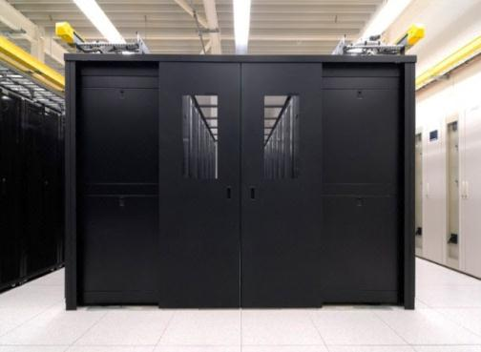
Interxion Cloud Hubs Data center becomes neutral Eco-System for delivering hybrid solutions
Enterprise Private Cloud
Infrastructure
“Dedicated, Performance, Secure, Uptime”
Public Cloud Infrastructure
“elasticity”
Access “connect to enterprise”
Software as a Service “pay as u use”

